Slide 1

Scraping Flights on TripAdvisor
By: Edwin Back

Slide 2
Methodology
Deployed Selenium to scrape TripAdvisor (dynamic site)
Eight total features extracted
Departure date
Price
Airline
Starting airport (origin)
Ending airport (destination)
Start and end time
Duration
Fly score
Added day of the week and month once data frame was created
Constraint: flight deals unavailable past 12/21/2020
Notes:
Used pandas for data wrangling and seaborn for plots, approx 92,000 data points collected
FlyScore is a combination of airline reviews, flight duration, comfort ratings, and amenities

Slide 3
Overview
Questions
How do prices fluctuate over a given year?
Is Tuesday really the best day of the week to book a flight?
What does the data say about the three NYC airports?
Findings
Further Analysis
Conclusions
Notes:
According to Forbes, airline industry is worth close to $35 billion and will continue to grow as we become a more global society
So, as we travel mo
Price fluctuation, can we see any trends?

Slide 4
Price fluctuation over a year?
Notes:
Are there any trends? Seasonal patterns? Cheapest and most expensive times?

Slide 5
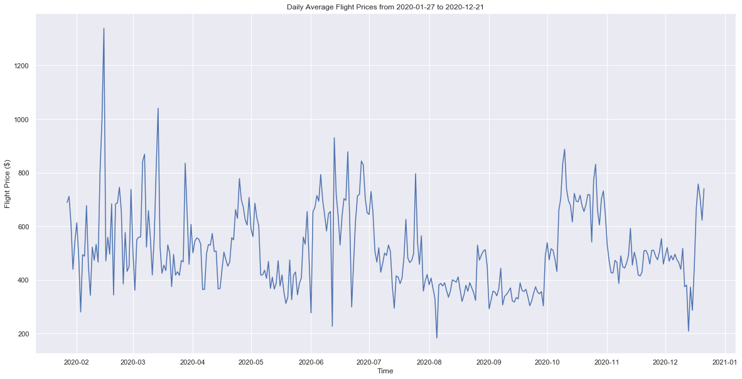
Notes:
Highest peaks are in February/March, June/July, October, December → average price of flights are highest during the middle of a season
Lowest valleys are following each high peak
Mid December (right before the holidays) prices drop approximately $300 then jump up
September prices have least variance and average price remains relatively constant

Slide 6
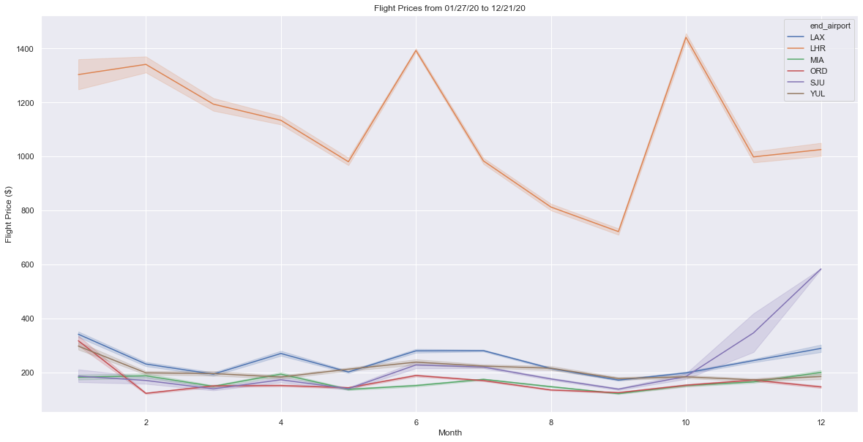
Notes:
March, May, and September have the lowest average prices for a majority of the destinations
Although Montreal and San Juan are technically international, they follow domestic price trends WHILE London (non-North America) has significant price variation
Prices to Chicago (ORD) drop from October to December while all other airports increase (it’s cold out there), while prices to San Juan and LA rise

Slide 7
2. Best day of the week to buy?
Notes:
Always heard that Tuesday is the best day to fly for cheap. Is this really true though? Let’s see if the data backs it up

Slide 8
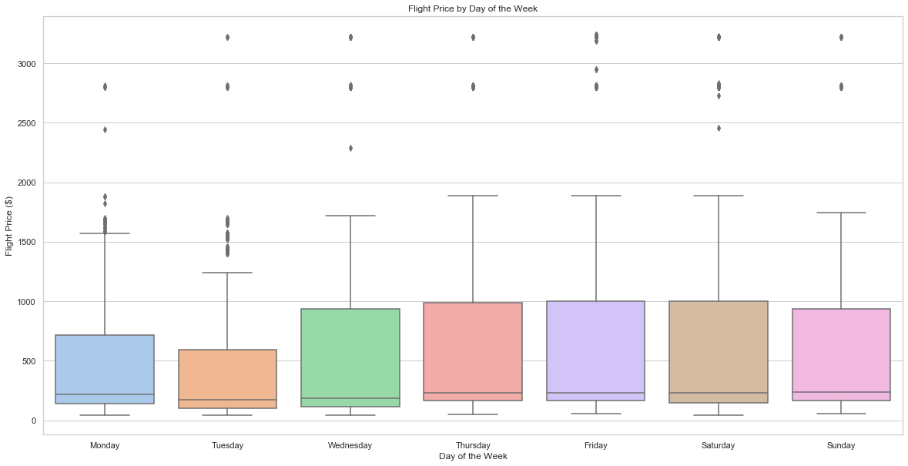
Notes:
Median price of flights is lowest on Tuesdays, but not by a large margin compared to other days.
However, the IQR of Tuesday is the smallest meaning that price variation on Tuesdays is at a minimum
Thursday, Friday and Saturday are equally the worst days to fly (weekend travel makes sense)
Mon, Tues, Wed are best days to fly/book flights

Slide 9
3. How do NYC airports stack up?

Slide 10
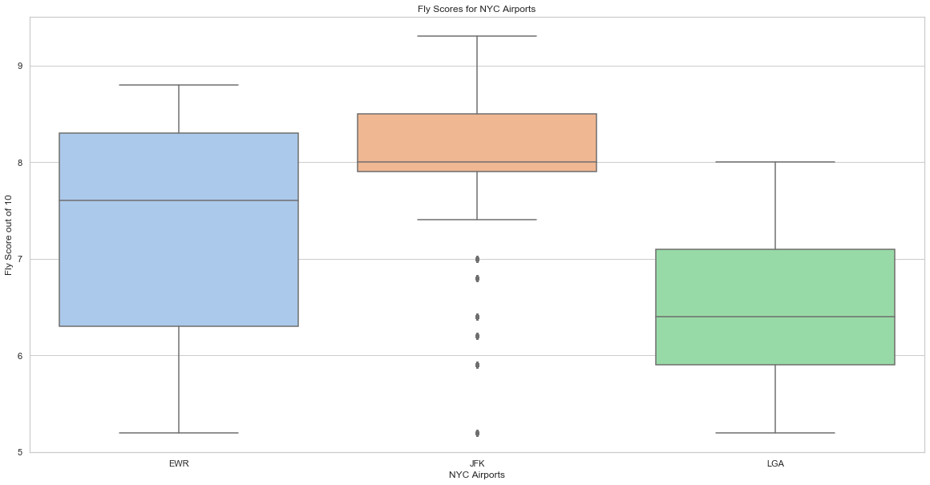
Notes:
Comparing JFK vs EWR vs LGA, all three serve domestic and intl flights
JFK has the best quality of flights based on median flyscorem, LGA has the worst quality
Minimum fly score for JFK is higher than LGA’s median and slightly below EWR’s median value

Slide 11
Further Analysis

Slide 12
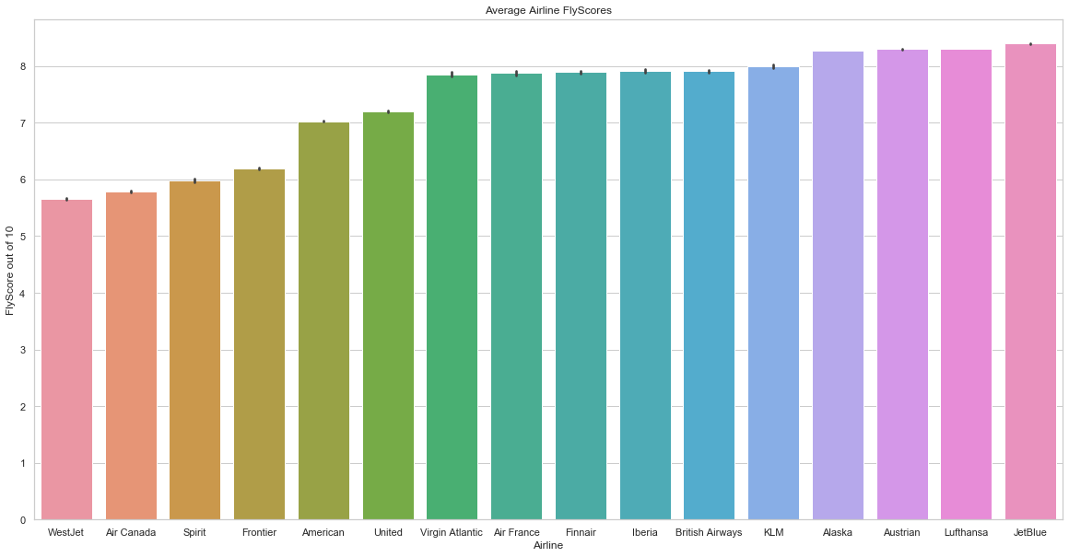
Notes:
Initial guess was that the American companies would be rated worse than the non-American companies.
This was MOSTLY true EXCEPT for JetBlue which had the highest average flyscore.

Slide 13


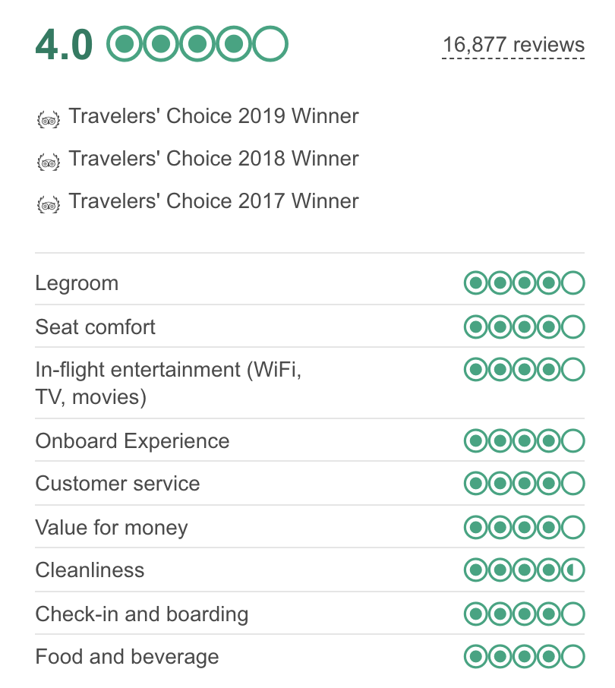
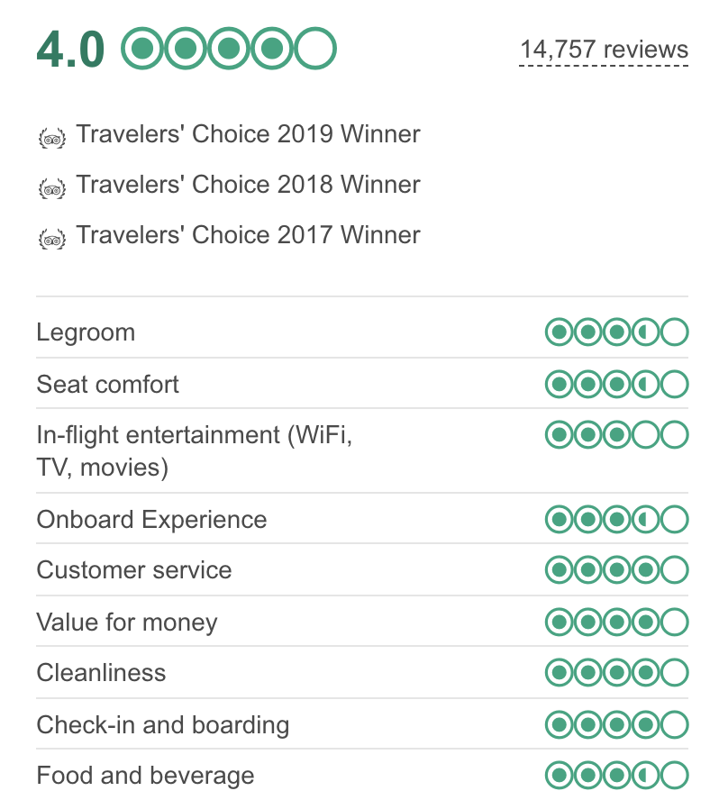
Notes:
Overall airline reviews are a large contributor to fly score but is not the end all be all
Same overall rating, but on different ends of the spectrum in terms of fly score
Might suggest that certain factors such as comfort/legroom, entertainment, and cleanliness are more heavily weighted than others

Slide 14
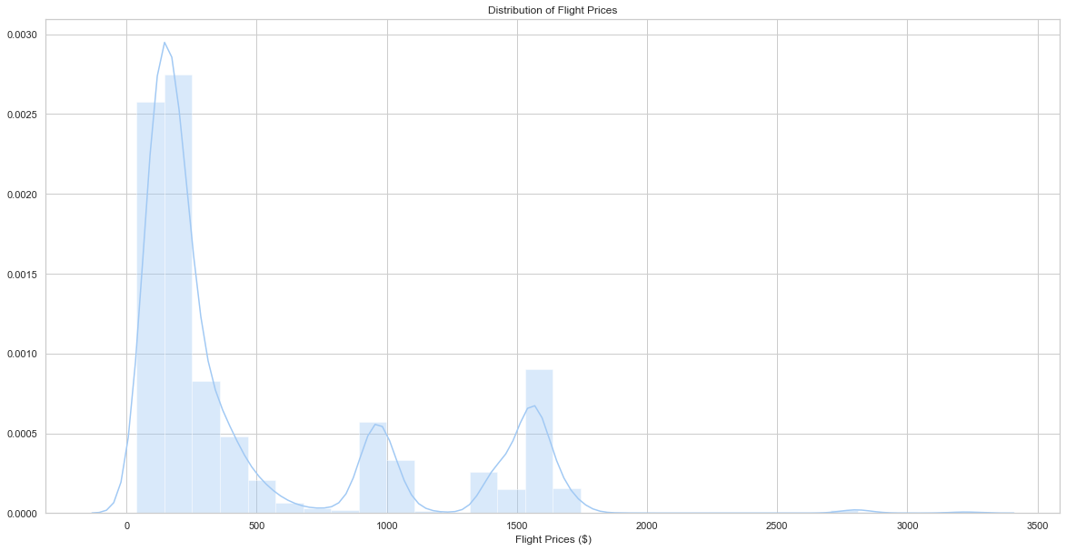
Notes:
Distribution of flight prices are left skewed, most deals are between $0 - $400
Pockets where there are little to no prices between $500 - $900 → if I am airline, I would try to discount expensive flights ($1000+) to this range in order to capture more customers that might be willing to pay this price, if available

Slide 15
Conclusions
Flights follow a seasonal trend, highest during middle of season
Best day of the week to buy flights is indeed Tuesday
JFK has the best quality of flights, LGA has the worst
Distribution of flight prices
Future work
Notes:
Future work would include:
Looking at historical flight price data and trying to be predict future prices
Try to see what length of round trip flights yields the best deals e.g. 1 week vs 2 weeks vs 1 month

Slide 16
Questions?

